Slide 1
SCALA IDE- ECLIPSE
SPARK RUN

Slide 2
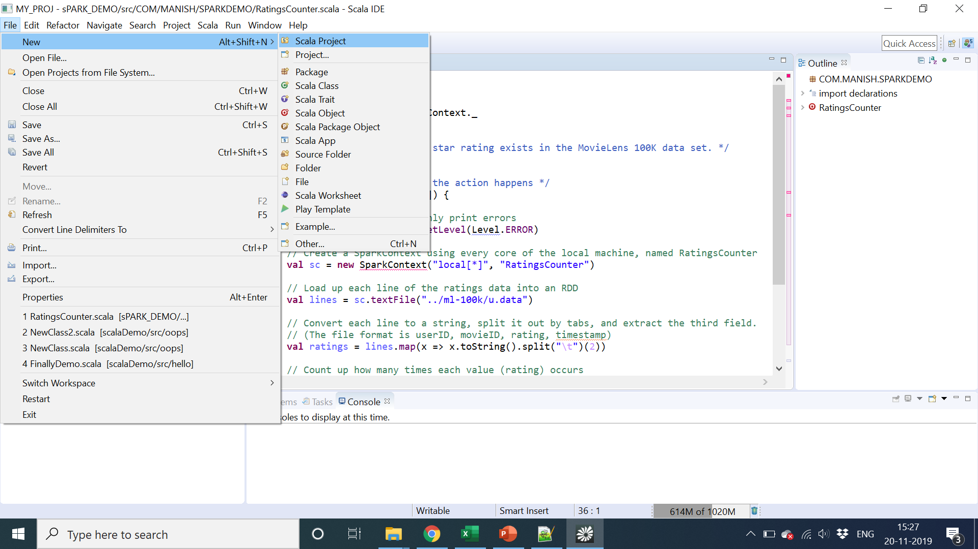

Slide 3
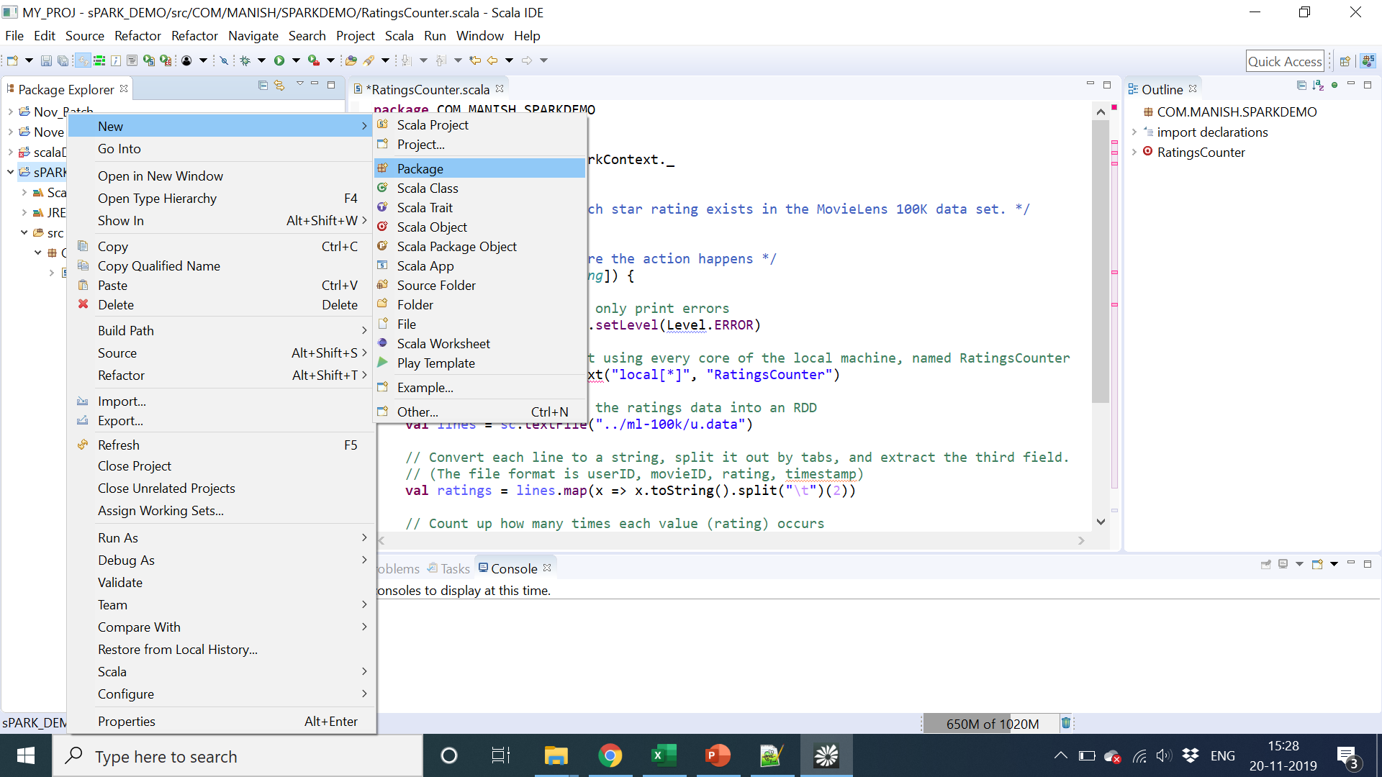

Slide 4
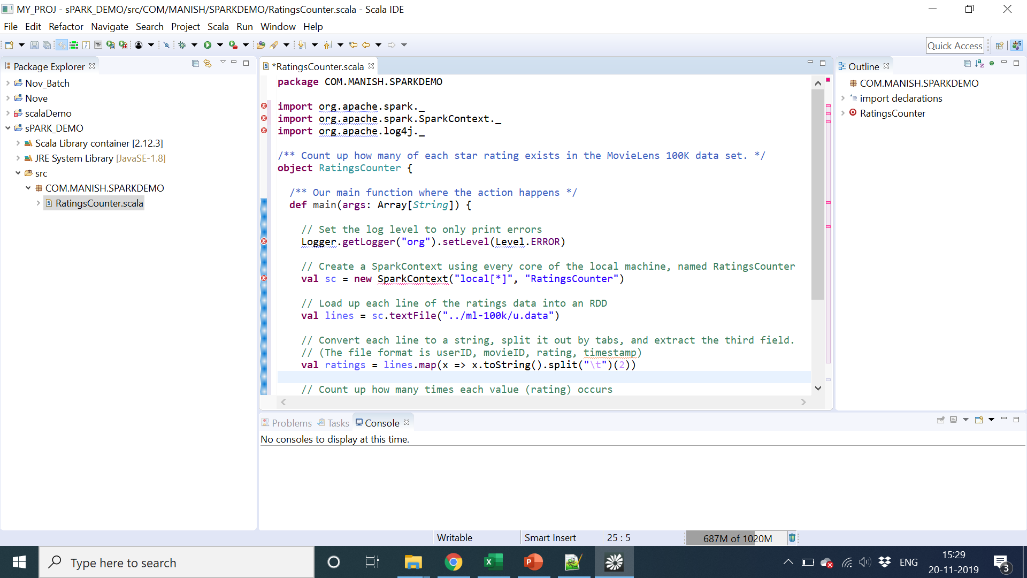

Slide 5
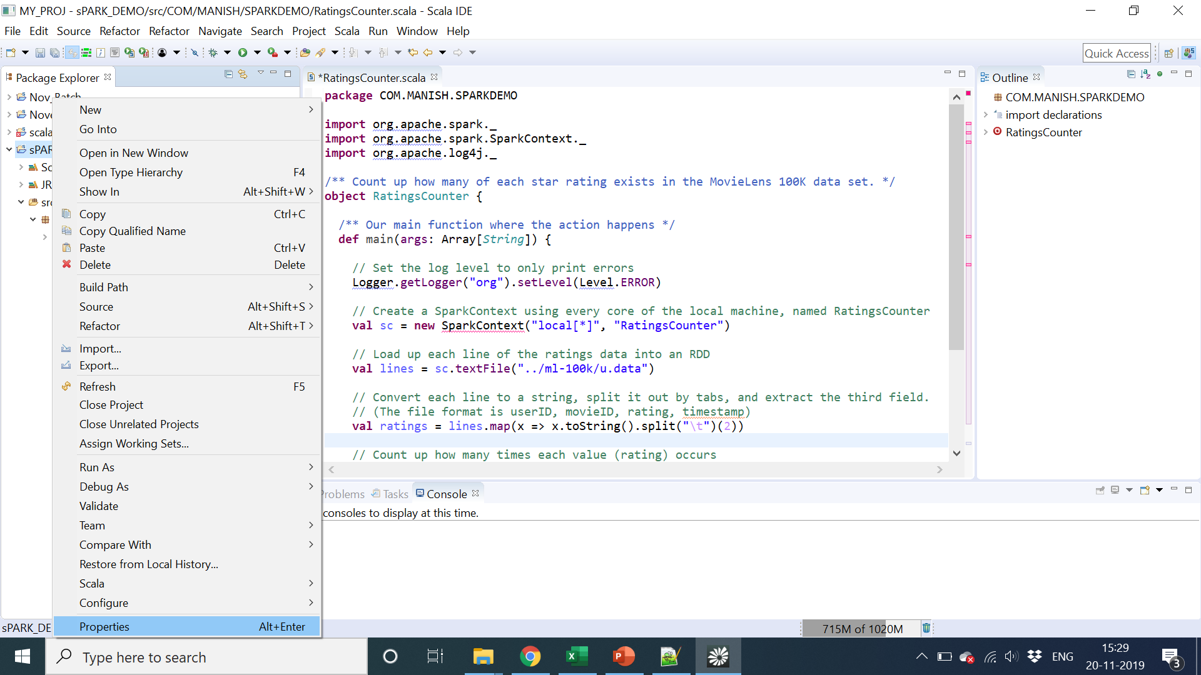

Slide 6
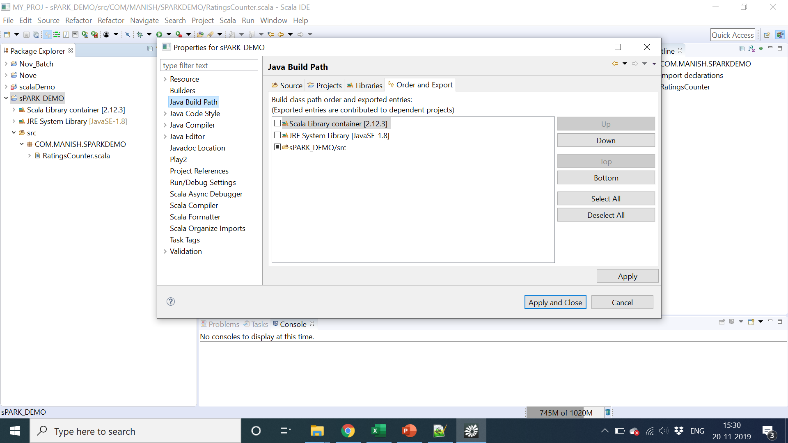

Slide 7
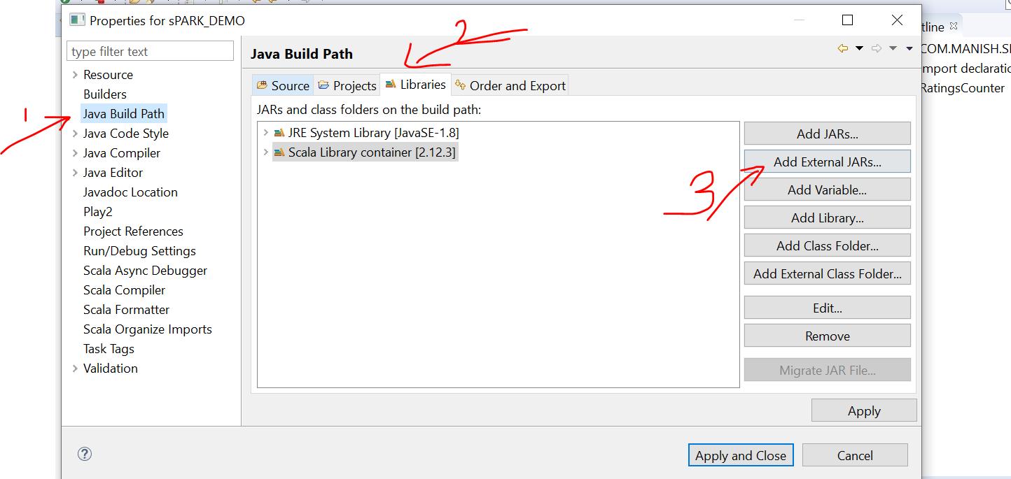

Slide 8
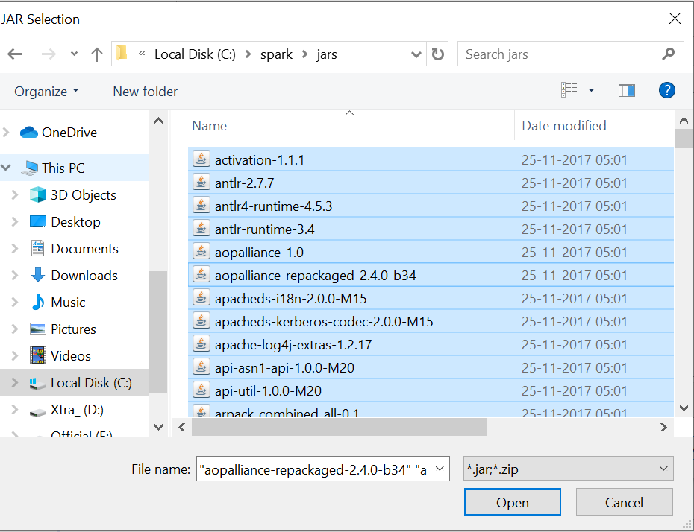

Slide 9
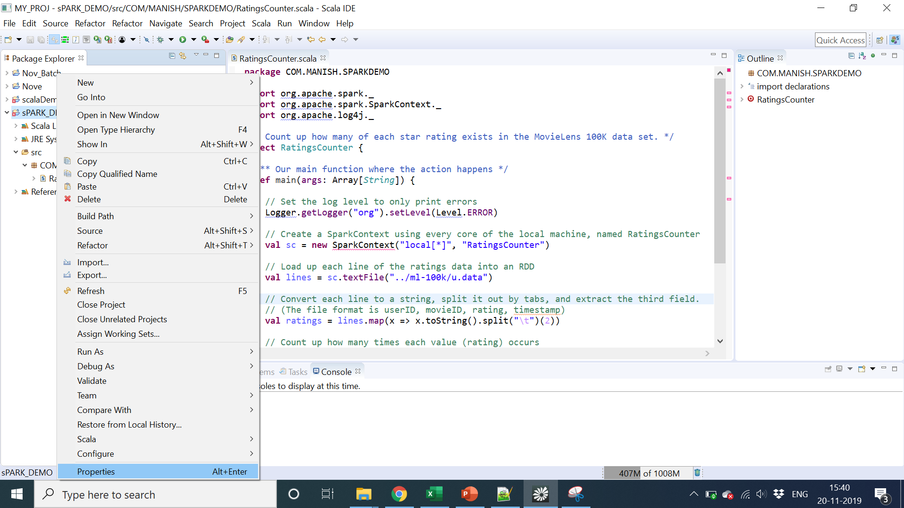

Slide 10
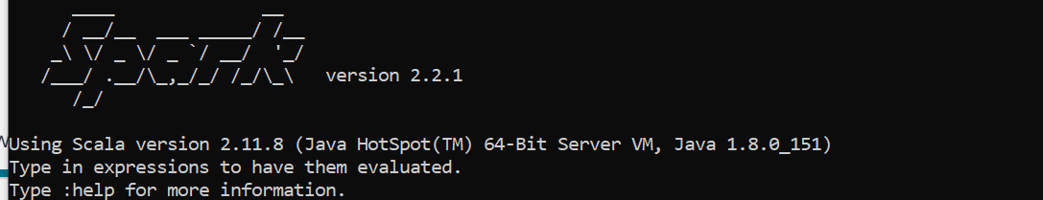
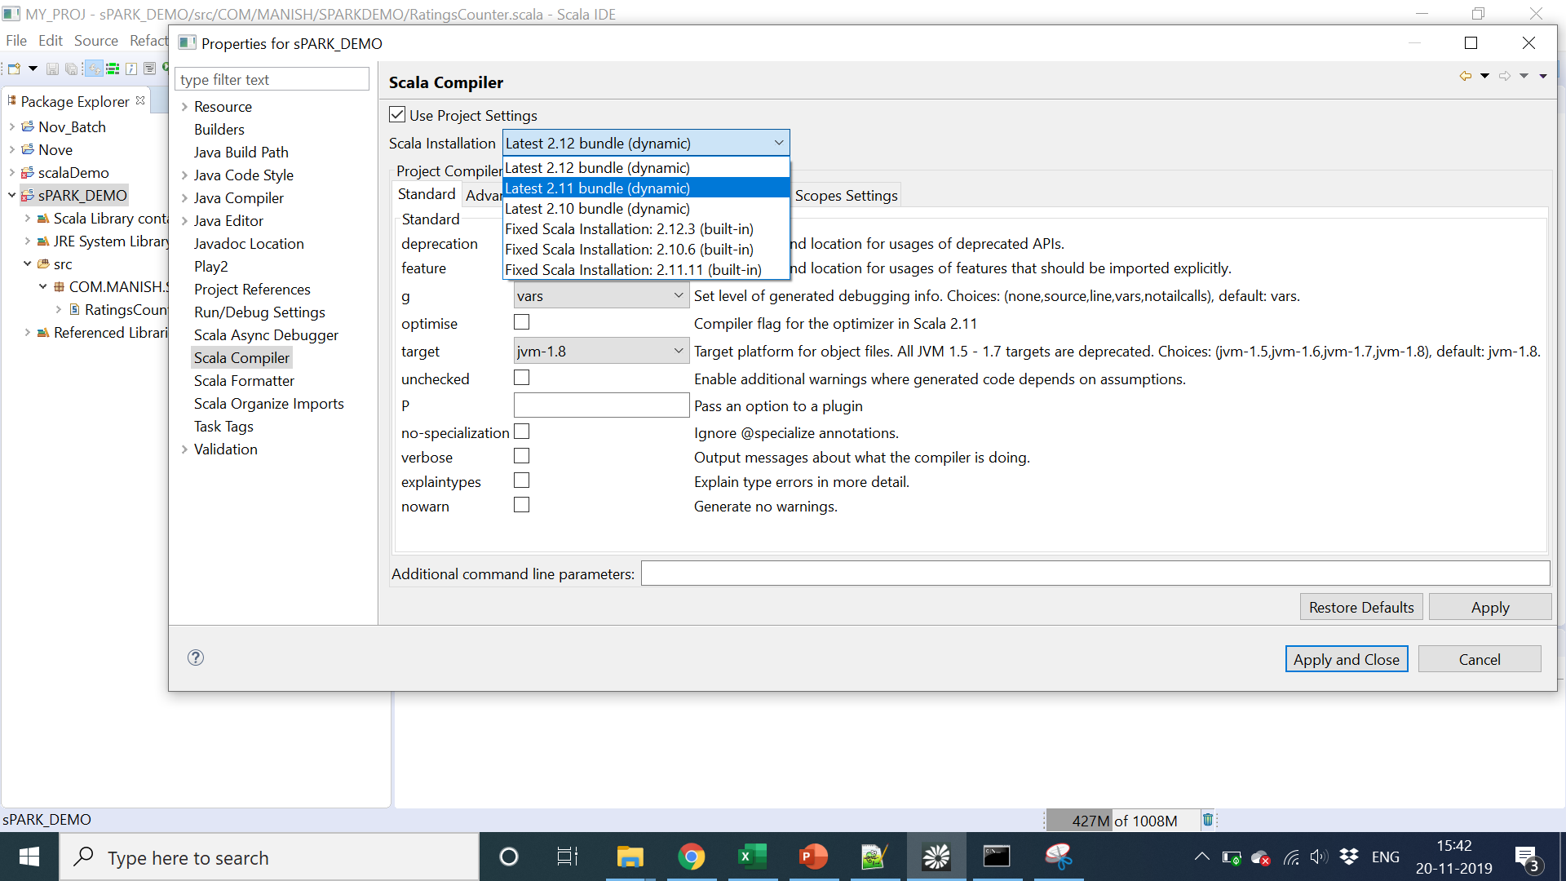

Slide 11
That’s ALL – All Error GONE……….

Slide 12
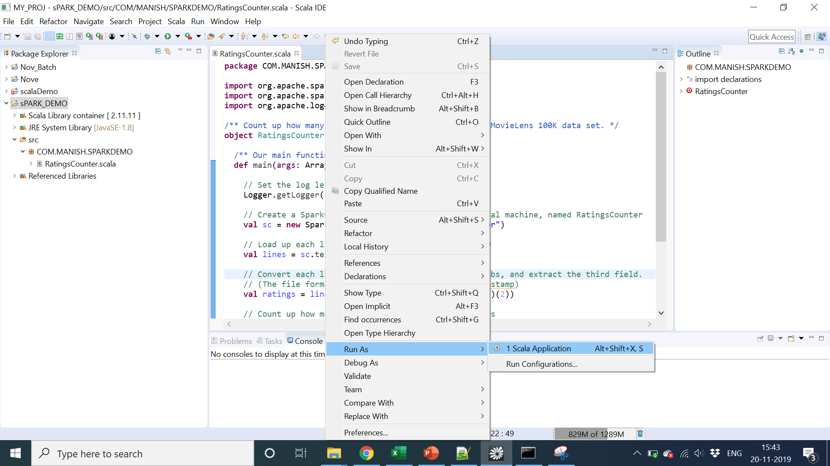

Slide 13
Copy DATA File in Workspace Directory

Slide 14
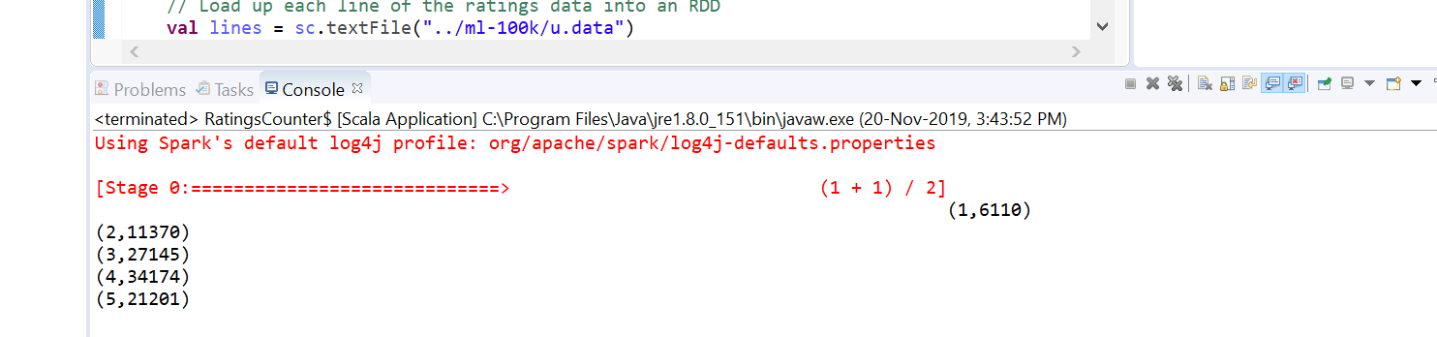

Slide 24
That’s ALL – All Error GONE……….

Slide 26
Copy DATA File in Workspace Directory

